Slide 1

This Photo by Unknown Author is licensed under CC BY-SA

Slide 2
Gps-tracking
“Track your child at anytime anywhere with ease”

Slide 3
Team Members
By
VISHNU VARDHAN (2110030139)
CHATURVEDA RAGHURAM (2110030182)
SAI KRISHNA (2110030092)
HARISH (2110030134)
Under the guidance of
(Dr.SUMIT HAZRA)

Slide 4

Table of Contents
Problem Statement and Domain
Existing Solution
Proposed Algorithm Design Technique
Data Structure Needed
GitHub setup
Work allocation to team member

Slide 5

Problem statement and domain
This project focused on how parents can keep track their
children movement to avoid child missing, kidnapping and etc.
By using GPS as a tracking too.
The three main reasons to develop the project are as below :
Increasing rate of child kidnapping
Lack of tracking technology for child.
Limited application for child monitoring

Slide 6

Existing solutions/ Naïve solutions
There Are few existing applications which can perform the
same activity
For Example Find my device,
Which do have some limitations
Need an WIFI connection
Also should be connected to the mail id
So, in our project we are all we need is just a phone No.
Which can track and sends you the last activity of your child

Slide 7
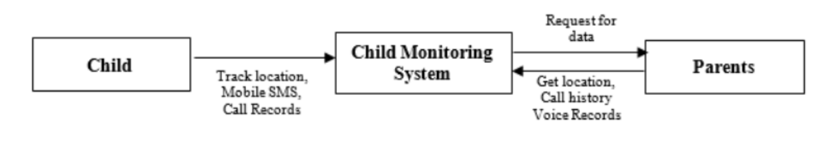
Proposed Algorithm
Block Diagram
In our proposed system, we emphasized the security of a child. This system consists of two sides:
Child and parent side. The main aim of this system helps parents to observe their children's activity from anywhere.

Slide 8

Design Technique
The main objective of the GPS Tracking System is to locate the person where he is and it will show the last location of where the person is there.
It manages all the information about the last location of the person and store in the data.
In the application, the interface will be very easy to understand so that the user can locate the person easily.
After getting the Latitude and Longitude location, it will redirect the location through maps.

Slide 9
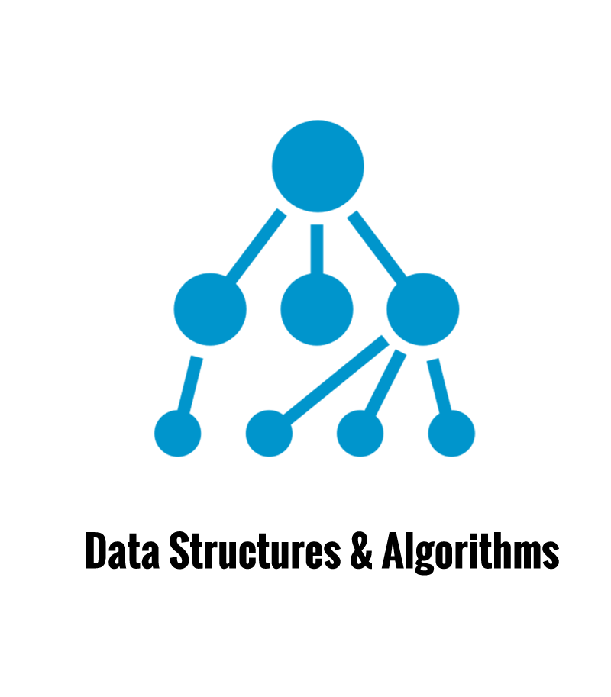
Data Structures needed
Tools : MySQL , TeraER
A data structure is a specialized format for organizing, processing, retrieving and storing data. There are several basic and advanced types of data structures, all designed to arrange data to suit a specific purpose.
We will be mainly Focusing on three main methods
Strings.
Recurssions.
Trees.

Slide 10
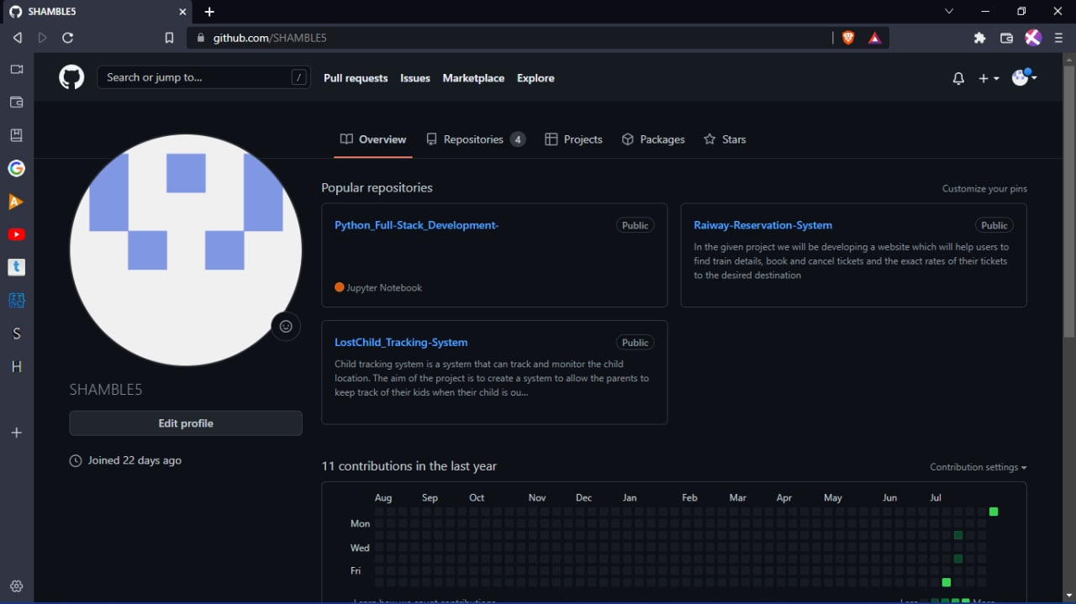

Github setup
Link to our repository is
https://github.com/SHAMBLE5/LostChild_Tracking-System

Slide 11
Division of work among the group members
Data set collection : G Vishnu Vardhan
Database management : D Chaturveda Raghuram and Harish
ER diagrams : Sai Krishna
Presentation making : All The Team Members w.r.t their work

Slide 12


